Slide 1
Problem Statement Worksheet (Hypothesis Formation)
How the sensor manufacturer company can accurately predict real data for pollutions like
CO, NO2, NOX and non-methanic hydrocarbons using sensor data and environmental factors?
H
1
Context
4
Constraints within solution space
The air pollution sensor manufacturing company, suspected that environmental factors like humidity and temperature cause deviation of sensor data from actual amounts. So, the company is looking to find the models to predict actual data from sensor data for sensors calibration. Each pollution can be predicted with different type of model.
The predicted models just incorporate temperature and humidity as environmental factors.
The predicted model does not consider time data.
2
Criteria for success
5
Stakeholders to provide key insight
Criteria to success would be having four models to predict CO, NOX, NO2 and non-methanic hydrocarbons actual data using sensor data with minimum mean absolute error and high R2 score.
Sensor manufacturing company, All the residents who live in the place where the sensors are installed.
3
Scope of solution space
6
Key data sources
The project scope just included air pollution real data, sensor data and humidity and temperature on hourly basis .
The dataset includes 9358 instances of hourly averaged responses from an array of 5 metal oxide chemical sensors embedded in an Air Quality Chemical Multisensor Device.
H
D
E
I
P
Notes:
Hypothesis: Create a Hypothesis with an emphasis on SMART principles. (S – Specific, M – Measurable, A – Achievable, R – Realistic, T – Timebound). If you cannot do this, you do not have a good grasp on the business problem.
Context: With context, we have clearly identified the problem at hand and have elucidated on how our initiative may solve this problem, alongside the commercial implications this will have on the business.
Criteria for Success: Clearly defining the criteria for success ensures that the scope of your work is clearly defined and understood. Otherwise, if this isn’t defined – your work will never end which will result in mismatched expectations.
Scope of Solution Space: Scoping out the solution space ensures that the business initiative is SPECIFIC for a certain segment or area. This prevents solutions that have been developed being scaled and applied for all other business units that the solution may not be responsible or scalable for.
Constraints within Solution Space: Looking forward, what are the foreseeable problems we are likely to encounter? Could this be stakeholder resistance? Could this be we don’t have access to the right data?
Stakeholders to provide key insight: Who are the people I need to speak to, to get the answers I need for my data analysis?
What key data sources are required?
Based off my discussions with the key stakeholders – can we clearly list out all the data sources we need so we can make a highly targeted request as opposed to a scatter-gun approach where we ask for a bit of everything?

Slide 2
Recommendation & Key Findings
What are the key findings in the analysis?
Humidity and temperature affect almost all of pollution predicting sensors containing oxygen specially NOX and NO2.
Humidity was more important than temperature for calibrating sensors
The order of importance of humidity and temperature on predicting real data from sensor data is:
NO2 > NOX > CO
Humidity and temperature don’t affect deviation of non-methanic hydrocarbons sensor data from actual amounts.
My Recommendations:
Installing air pollution sensors in a chamber which prevents temperature and humidity effects on them
Using linear regression for predicting CO and non-methanic hydrocarbons data, decision tree for NOX data and random forest for NO2 data
More research should be done on predicting NO2 data. Even using random forest and considering temperature and humidity, there was some difference between model prediction and actual amounts.

Slide 3
Which models were used to predict actual pollutions from sensor data?
Linear Regression for Predicting Actual CO Pollution:
Actual CO Pollution= 1.27 * (Sensor CO Pollution) + 0.11* (Temperature) -0.19 (Humidity)
R2 Score= 0.79
Cross Validation Score=0.78
Average CO Pollution Actual Amount= 2.11
Mean Absolute Error= 0.48
Linear Regression for Predicting Actual Non-Methanic Hydrocarbon (NMH) Pollution:
Actual NMH Pollution= 185*(Sensor NMH Pollution) - 4.1*(Temperature) + 0.15*(Humidity)
R2 Score= 0.78
Cross Validation Score=0.72
Average Non-Methanic Hydrocarbon Pollution Actual Amount= 216
Mean Absolute Error= 69
Decision Tree for Predicting Actual NOX Pollution:
R2 Score= 0.80
Cross Validation Score=0.64
Average NOX Pollution Actual Amount= 242
Mean Absolute Error= 62
Random Forest for Predicting Actual NO2 Pollution:
R2 Score= 0.56 ,
Cross Validation Score=0.54
Average NO2 Pollution Actual Amount= 112
Mean Absolute Error= 23

Slide 4
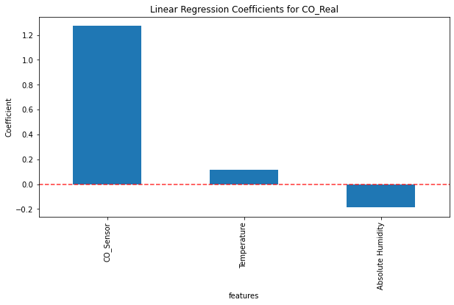
Which Features were important in predicting the real CO data?
Temperature had positive effect on CO actual amount
Humidity had negative effect on CO actual amount

Slide 5
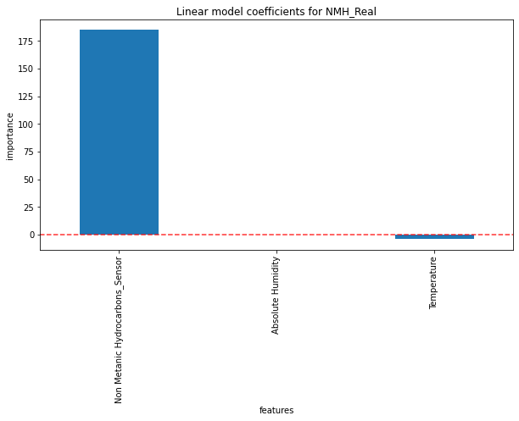
Which Features were important in predicting the real non-methanic hydrocarbons data?
Humidity and temperature had very little effect on prediction of non-methanic hydrocarbons real amount.

Slide 6
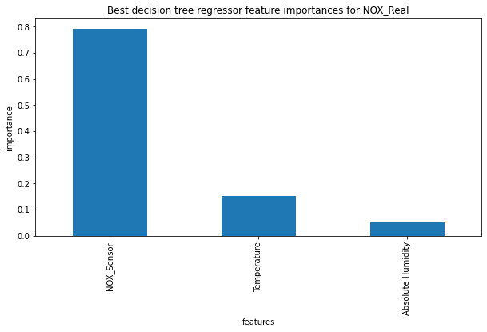
Which Features were important in predicting the real NOX data?
Humidity had 5% importance on NOX actual amount.
Temperature had 15% importance on NOX actual amount.

Slide 7
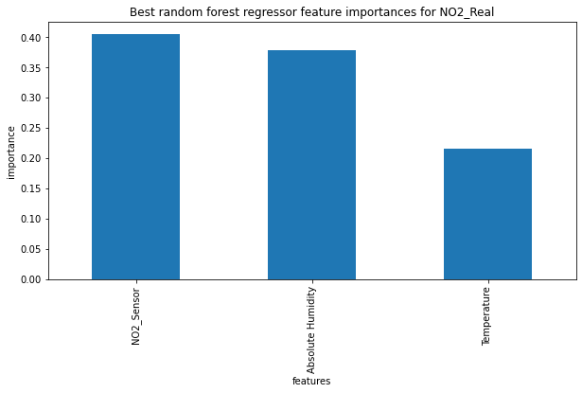
Which Features were important in predicting the real NO2 data?
Humidity had 37% importance on NO2 actual amount.
Temperature had 22% importance on NO2 actual amount.
Humidity and temperature had great importance in prediction of NO2 real amounts.

Slide 8
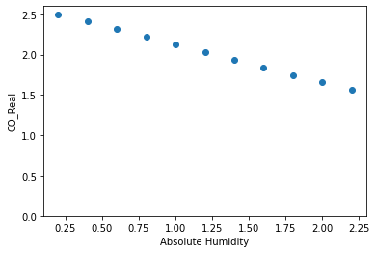
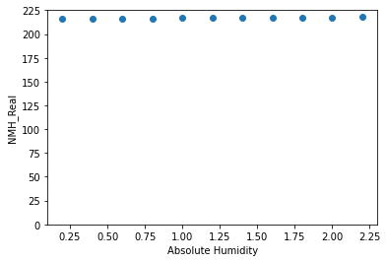
What was Humidity effect in constant temperature and sensor amount? (Humidity Range: 0.2-2.4)
Humidity Did not affect prediction of non-methanic hydrocarbons real amounts.
Increasing humidity between low and high ranges, decreased CO real amounts around 30%.
CO
Non-Mthanic Hydrocarbons

Slide 9
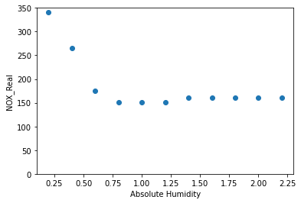
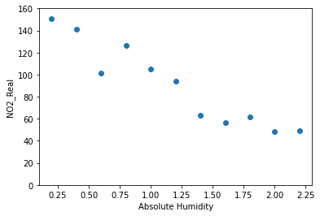
What was Humidity effect in constant temperature and sensor amount? (Humidity Range: 0.2-2.4)
Low ranges of humidity ( between 0.2-0.75) affected NOX real amounts.
Higher humidity , affected NO2 real amounts negatively.

Slide 10
Summary & Conclusion
Temperature and humidity are very important for calibration of NO2, NOX and CO pollution sensors.
CO and non-methanic hydrocarbons real amounts could be predicted by linear regression model
Decision tree model was good for predicting NOX real amounts.
Random forest model was good for predicting NO2 real data.
Increasing humidity in constant temperature and sensor amounts, decreased NO2,NOX and CO actual amounts.
Future Steps:
More exploration should be done for finding better model for predicting NO2 data since the r2 score was around 0.6 and mean absolute error was still high.
The effects of other environmental factors like air pressure or interferences of other pollutants can be investigated on predicting real data from sensor data.

